Slide 1

Cluster analysis, classification
Szymon Łukasik
Faculty of Physics and Applied Computer Science

Slide 2

Task of clustering
The task of cluster analysis (or: clustering) is a division of the dataset into groups (clusters) such as the elements belonging to one cluster similar to each other and assigned to different clusters - are dissimilar.
The measure of similarity/dissimilarity used in clustering is a distance measured with selected metric.
The applications of clustering are very broad and include social sciences, economy, engineering and biomedical sciences.
Clustering is an unsupervised learning problem, i.e. in general the knowledge regarding the relations between data sample elements is not needed (although most methods implicitly or explicitly require the number of clusters as the input parameter).

Slide 3
Let’s see it
This distance should be maximized
This distance is to be minimized

Slide 4
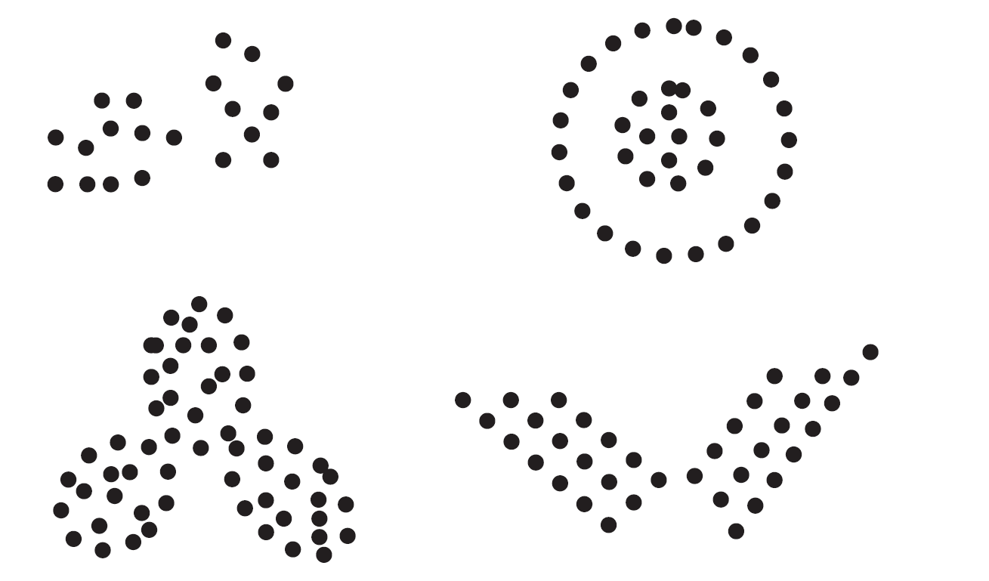
Subjectivity in clustering

Slide 5
How many clusters?
How many clusters you can distinguish?
Maybe six?
Two?
Or maybe… four?

Slide 6
Clustering methods
Fundamental approaches to clustering:
K-means and its variants
Hierarchical clustering
Density-based clustering
In the course of this lecture you will get familiar with k-means algorithm, hierarchical methods and DBSCAN – the most popular density-based algorithm
We will also take a brief look at clustering evaluation measures.

Slide 7
K-means algorithm (MacQueen, 1967)
1. Assume number of clusters k.
2. Randomly generate clusters’ centers locations µ_{i} , i=1,…,k.
3. Assign all data elements to the clusters with the closest center.
4. Determine location of new clusters’ centers as means of points assigned to each of them.
5. Repeat steps 3-4 until in 4 no change in assignement of points into clusters was made.
Efectively K-means locally minimizes the following cost indicator:

Slide 8
Initial conditions problem 1/2

Slide 9
Initial conditions problem 2/2

Slide 10
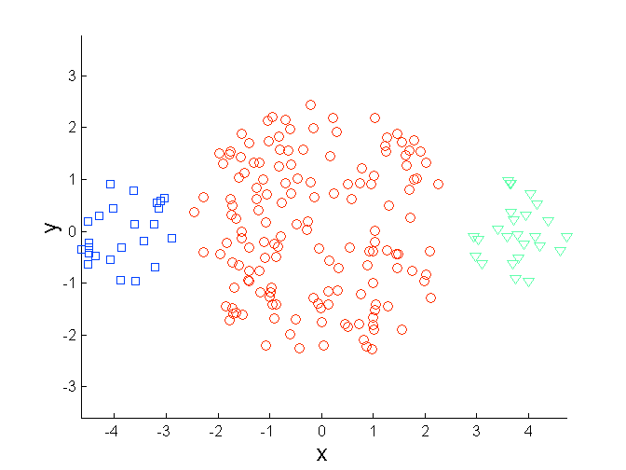
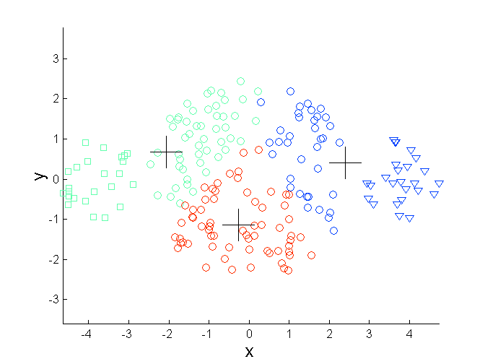
Other limitations – uneven cluster sizes

Slide 11
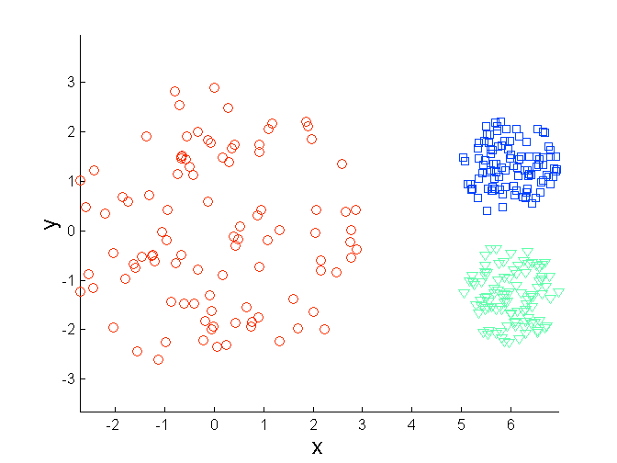
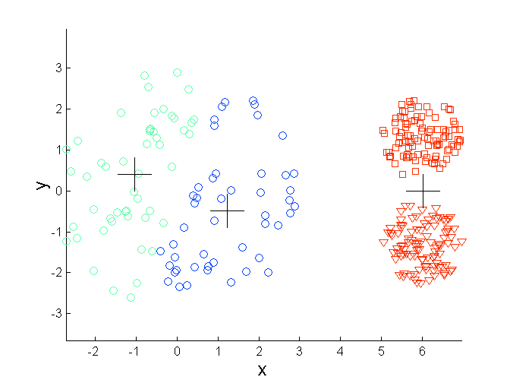
Other limitations – different densities

Slide 12
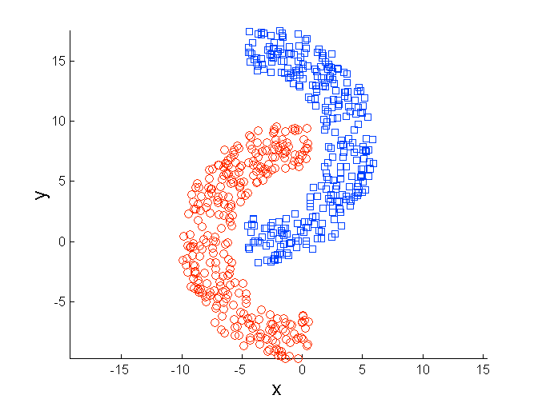
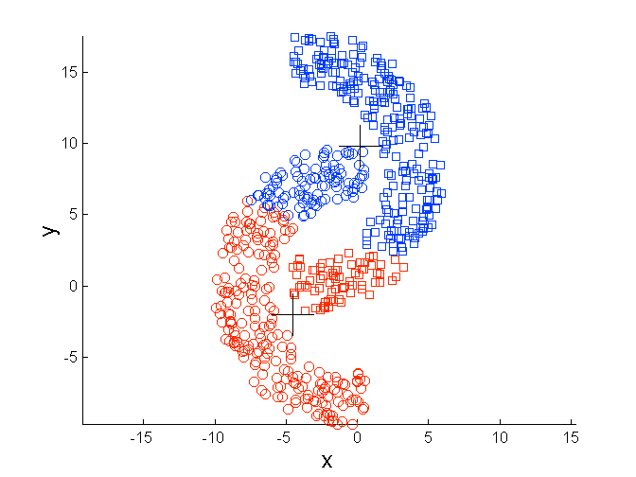
Other limitations – irregular shapes

Slide 13
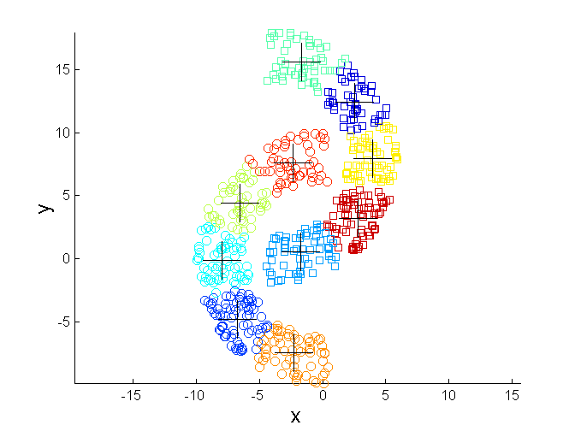
Irregular shapes – set higher k

Slide 14
Hierarchical clustering (Jardine, Sibson, 1971)
The result of hierarchical clustering is a tree which could be visualized as a dendrogram. It is in fact a sequence of clustering solutions of varying granularity.

Slide 15
Few words of introduction…
Hierarchical clustering can be performed using two alternative top-down, and down-top approaches. First is called hierarchical clustering and second is named as agglomerative clustering.
Agglomerative clustering is the more popular method. It relies on iterative link of two closest pair of clusters into one, with the assumption that in the firs iteration each data element is a cluster.
Different algorithm belonging to this class are characterized by alternative ways of measuring distance between clusters.

Slide 16
Initial solution
p1
p2
p3
p4
p5
. . .
p1
p2
p3
p4
p5
.
.
.
Distance matrix

Slide 17
After some iterations
C1
C2
C3
C4
C5
C1
C3
C2
C4
C3
C4
C1
C5
C2
C5

Slide 18
How it happened?
C1
C2
C3
C4
C5
C1
C3
C2
C4
C3
C4
C1
C5
C2
C5

Slide 19
What to do with the matrix?
C2 U C5
C1
C3
C4
C3
C1
?
C4
?
?
?
?
C2 U C5
C3
?
C1
C4
?
C2 U C5

Slide 20
Few solutions
MIN
MAX
Group average
Distance between centers
Other methods using cost functions (e.g. Ward algorithm)

Slide 21
Few solutions
MIN
MAX
Group average
Distance between centers
Other methods using cost functions (e.g. Ward algorithm)

Slide 22
Few solutions
MIN
MAX
Group average
Distance between centers
Other methods using cost functions (e.g. Ward algorithm)

Slide 23
Few solutions
MIN
MAX
Group average
Distance between centers
Other methods using cost functions (e.g. Ward algorithm)
×
×

Slide 24
Comparison
The closest clusters are the ones for which the linkage results in the lowest increase in mean square error
MIN
MAX
Group average
Ward method

Slide 25
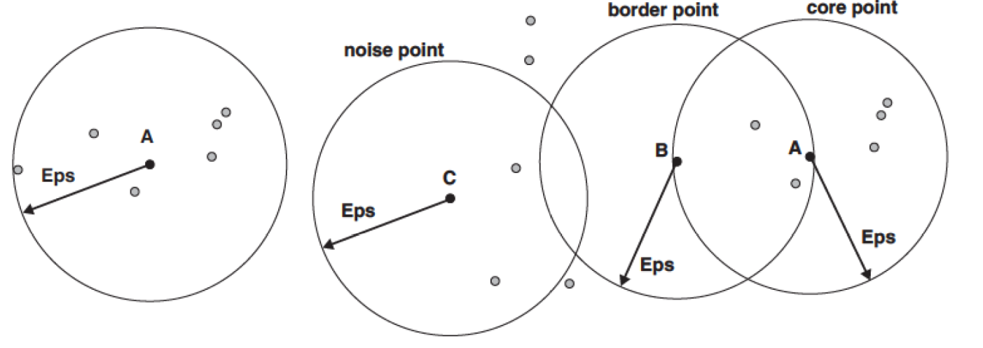
DBSCAN algorithm (Ester et al., 1996)
Density – number of points belonging to the sphere around selected data element of radius Eps
Core point – point which has more than MinPts points in its neighborhood of Eps radius
Border point – point which is not a core point but in its neighborhood of Eps radius has at least one core point
Noise point – not a core, nor a border point

Slide 26
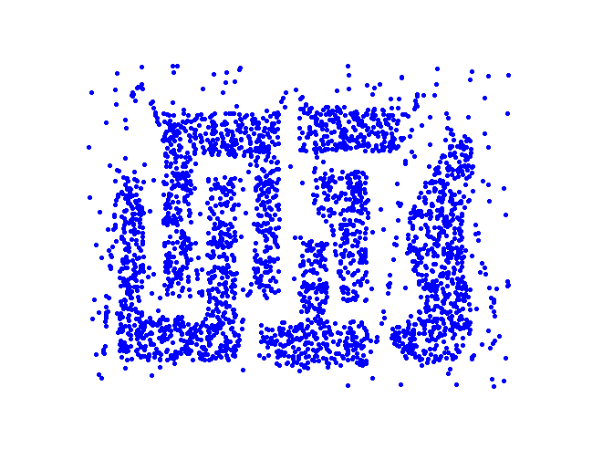
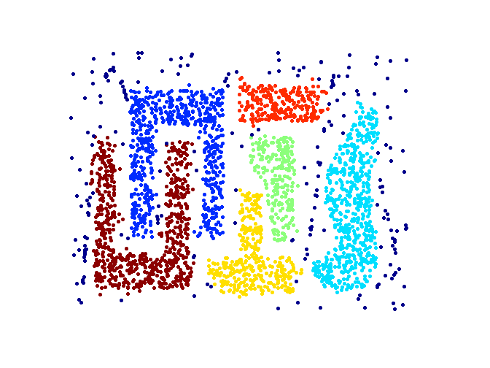
DBSCAN algorithm
Steps of DBSCAN:
Assign all points to core, border or noise points groups. Remove noise points.
Assign all core points lying within Eps distance to one cluster.
Assign border points to the clusters associated with their core points (core points in which neighborhood they are situated).

Slide 27
How to evaluate clustering result?
Why we evaluate clusterings?
To judge when to stop hierarchical clustering or to determine if algorithm’s parameters were set properly. In general: to evaluate the geometrical quality of obtained clustering.
To compare two clusterings obtained with different methods.
To determine if selected method gives good results (if we know expected result).
How to evaluate clusterings?
If we have reference result of clustering (cases 2-3) – Rand index or other external validity indices
If we want to get quantitative evaluation of single solution (case 1) – internal validity indices.

Slide 28
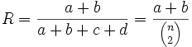
Rand index
a – number of pairs of points belonging to the same clusters in solution I and II
b – number of pairs of points belonging to different clusters in solution I and II
c – number of pairs of points belonging to the same clusters in solution I and different in solution II
d – number of pairs of points belonging to different clusters in solution I and the same clusters in solution II

Slide 29
Internal validation
Two typical components of internal validation:
Cluster cohesion (CC)
Cluster separation (CS)
Typical examples of internal validation: Davies-Bouldin and Dunn indices.
Interestingly sum of CC and CS is the same for any two clusterings of the same dataset.

Slide 30
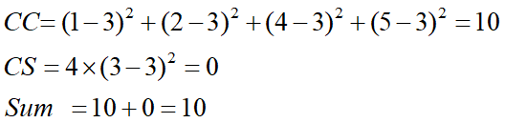
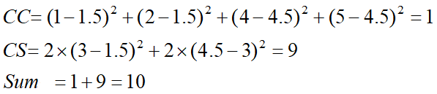
Coherence and separation
µ
×
×
×
1
µ ₁
2
3
4
µ ₂
5
K=1 cluster:
K=2 clusters:

Slide 31
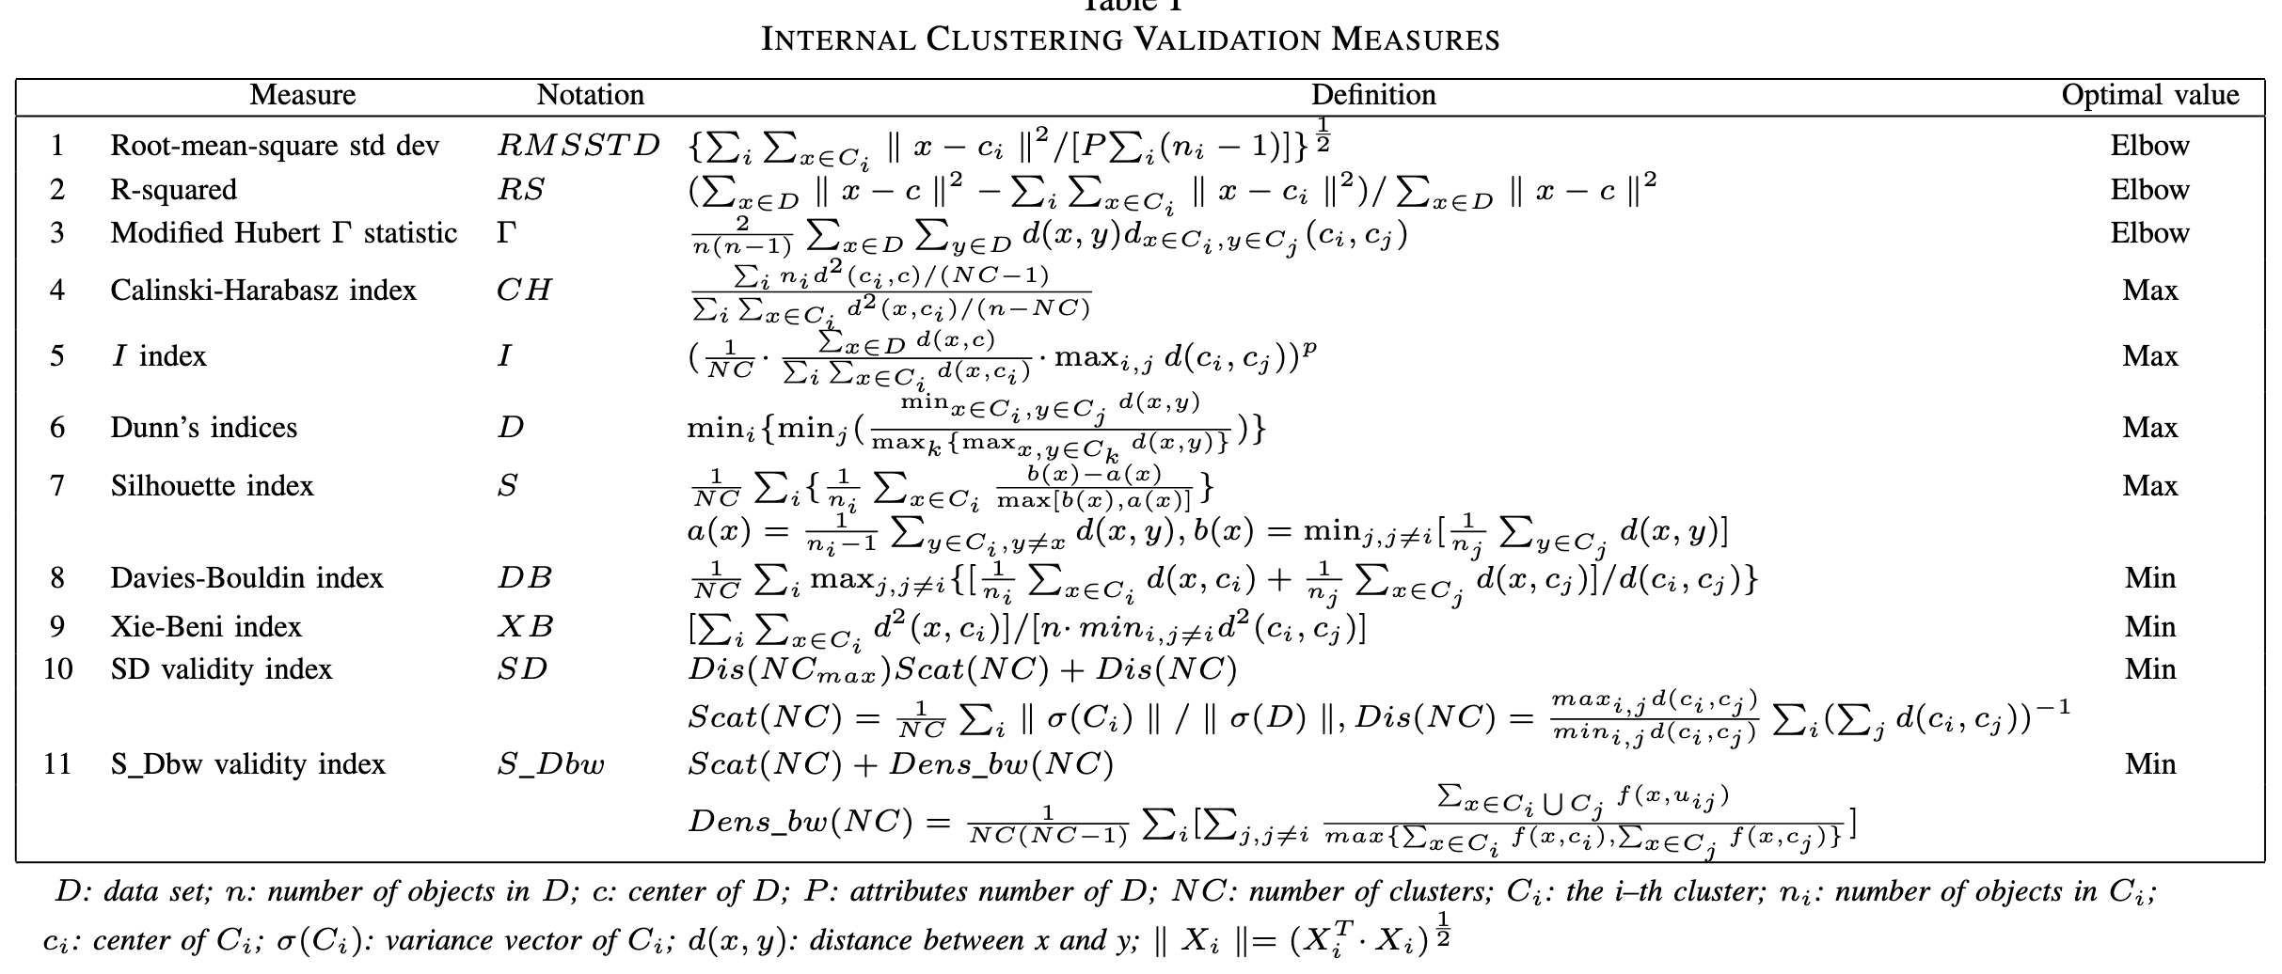
Internal validation indices
Source: Yanchi Liu et al., “Understanding of Internal Clustering Validation Measures”, 2010.

Slide 32
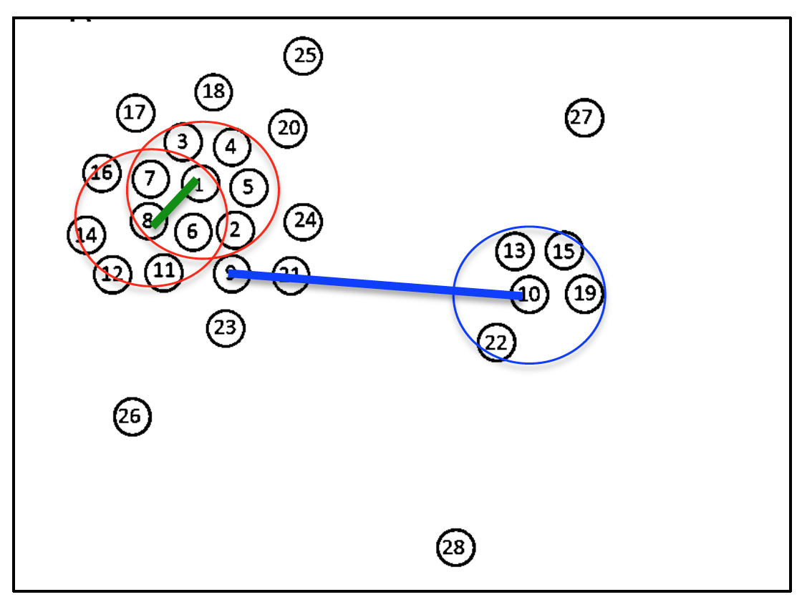
Clustering by fast search and find of density peaks
Algorithm developed in 2014 (Rodriguez, Laio, Science, vol. 344, 2014) – has already many modifications and has been cited over 2500 times. Simple concept and computationally attractive.
1. We calculate local density around each point
g(1)=7
g(8)=5
g(10)=4
2. For each point calculate distance from points of higher density, find minimum.

Slide 33
Clustering by fast search and find of density peaks
3. Plot values of minimum in function of density
Outliers seen on this plot represent cluster centers.

Slide 34
Clustering by fast search and find of density peaks
Point is assigned to clusters to which the closest point of higher density is assigned.
Only parameter – cut-off distance.

Slide 35
Task of classification
We have a dataset with class labels being available (training set). The task of classification is constructing a model returning class labels for new data
Dataset for which no class labels are available which is used to evaluate classification accuracy is called a testing set.

Slide 36
Classification algorithms
Decision trees
Rule-based methods (e.g. using fuzzy logic)
Neural networks
Memory-based algorithms
Bayesian classifiers
Support Vector Machines
Instance-Based Learning

Slide 37
Decision trees
K
C
E
Testing data
K
Splitting Attributes
Model
Refund
Yes
No
NO
MarSt
Single, Divorced
Married
TaxInc
NO
< 80K
> 80K
NO
YES
Training data

Slide 38
Decision trees – uniqueness problem
K
K
C
E
Model
MarSt
Single, Divorced
Married
NO
Refund
Yes
No
NO
TaxInc
< 80K
> 80K
NO
YES
Learning data

Slide 39
Methods of decision trees induction
Fundamental algorithms for tree-based classification:
Hunt algorithm
CART
ID3, C4.5
SLIQ, SPRINT

Slide 40
Hunt algorithm
Let D_{t} be a set of records analysed in t node
Procedure of tree construction:
If D_{t} contains only records belonging to class y_{t}, assign t leaf label y_{t}
If D_{t} is an empty set, assign t t default class label y_{d}
If D_{t} contains records belonging to more than one class use a condition for attribute values to split the dataset into smaller subgroups.

Slide 41
Hunt algorithm
Refund
Yes
No
Don’t
Cheat
Don’t
Cheat
Refund
Yes
No
Don’t
Cheat
Marital
Status
Refund
Single,
Divorced
Married
Yes
No
Don’t
Cheat
Marital
Status
Taxable
Income
Don’t
Cheat
Single,
Divorced
Married
< 80K
>= 80K
Cheat
Don’t
Cheat
Don’t
Cheat
Cheat

Slide 42
Dividing set of records
The division of records in a node (not being a leaf) should be performed according to some criterion.
Problem is definining how to do the division but also when to stop – and assume that the node is in fact a leaf (in Hunt algorithm we stop dividing only when the node is uniform in terms of class labels)
The way the set of records is divided depends on measurement scale of selected attribute.

Slide 43
Division criteria
Usually division criterion is homogeneity of newly-created children nodes
Exemplary criteria: entropy, classification error or Gini index.
Non-homogenous
Homogenous

Slide 44
Division – general scheme
Before the division:
M0
A?
B?
Yes
No
Yes
No
Node N1
Node N2
Node N3
Node N4
M1
M2
M3
M4
M12
Compare M0 – M12 vs M0 – M34
M34

Slide 45
Naïve Bayes classifier
This simple but effective classifier is based on the well-known Bayes theorem:
Example:
House MD knows that 50% of people affected by lupus (event T) suffers from serious rash (event W) – in other words: P(W|T)=0.5. In general population lupus occurs in 1 per 50 000 people (i.e. P(T)=1/50000), and rash for 1 per 20 people (P(W)=1/20). What is a probability of having a lupus when rash was already diagnosed?

Slide 46
Naïve Bayes classifier – how it works?
Let each attribute and class label represent random variable
Having a set of attribute values (A₁, A₂,…,A_{n})
The aim is to predict a value of class label C
To put it using statistical rigor: we want to find a value of C which maximizes P(C| A₁, A₂,…,A_{n} )
Is it possible to estimate a value of P(C| A₁, A₂,…,A_{n} ) directly from the data?

Slide 47
Naïve Bayes classifier – how it works?
Algorithm:
Calculate P(C | A₁, A₂, …, A_{n}) for each C using Bayes theorem:
Use value of C which maximizes P(C | A₁, A₂, …, A_{n})
It is equivalent to find C which maximizes P(A₁, A₂, …, A_{n}|C) P(C)

Slide 48
Naïve Bayes classifier – how it works?
Let us assume that values of attributes A_{i} are independent for given class:
P(A₁, A₂, …, A_{n} |C_{j}) = P(A₁| C_{j}) P(A₂| C_{j})… P(A_{n}| C_{j})
Are we able to estimate P(A_{i}| C_{j}) for all A_{i} and C_{j}?
Record is classified as C_{j} if P(C_{j}) Π P(A_{i}| C_{j}) is maximum.

Slide 49
Calculating probabilities
Class labels: P(C) = m_{c}/m
e.g. P(No) = 7/10, P(Yes) = 3/10
For discrete attributes: P(A_{i} | C_{k}) = |A_{ik}|/ m_{c}
where |A_{ik}| is the number of cases having attribute value A_{i} and belonging to class C_{k}
Examples :
P(Status=Married|No) = 4/7 P(Refund=Yes|Yes)=0

Slide 50
Probabilities – continuous variables
We assume normal distribution, then for each pair (A_{i},c_{i}) :
E.g.. for (Income, Class=No):
If Class=No
μ = 110
V = 2975
Then :

Slide 51
Example
To classify:
X=(Refund = No, Married, Income = 120K)
P(X|Class=No) = P(Refund=No|Class=No) × P(Married| Class=No) × P(Income=120K| Class=No) = 4/7 × 4/7 × 0,0072 = 0,0024
P(X|Class=Yes) = P(Refund=No| Class=Yes) × P(Married| Class=Yes) × P(Income=120K| Class=Yes) = 1 × 0 × 1,2 × 10⁻⁹ = 0
We find that P(X|No)P(No) > P(X|Yes)P(Yes)
Then P(No|X) > P(Yes|X) => Class = No

Slide 52
Hunting
A: attributes
M: mammals
N: non-mammals
P(A|M)P(M) > P(A|N)P(N)
=> Mammals

Slide 53
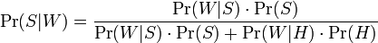
Spam classification with Naïve Bayes
Let W be a word (e.g. part of the body, name of medicine, watch etc.) which presence indicates a message as spam/ham. We denote respective values as W, S, H.
We use alternative form Bayes theorem:
where:
Pr(S|W) is a probability that a message is a spam knowing it contains word W, Pr(S) and Pr(H) are probabilities that message is a spam/ham, and probabilities Pr(W|S) and Pr(W|H) correspond to a probability of finding word W in spam and ham messages.
Assumptions: it is estimated that spam ration equals to 80% messages, however it is assumed that Pr(S)=Pr(H)=1/2. Pr(W|S) and Pr(W|H) are estimated during training.

Slide 54
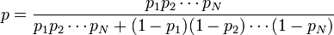
Many words
Message containing N different words W₁, W₂, …, W_{N} is classified as spam if p is higher then threshold value. Note that: p₁ =P(S|W₁), p₂=P(S|W₂) etc..
Fundamental assumption: the presence of different words is independent from each other – oversimplification!

Slide 55
K-nearest neighbor
Distance
Test case
Training set
Select k-closest records from the training set

Slide 56
K-nearest neighbor methods

Slide 57
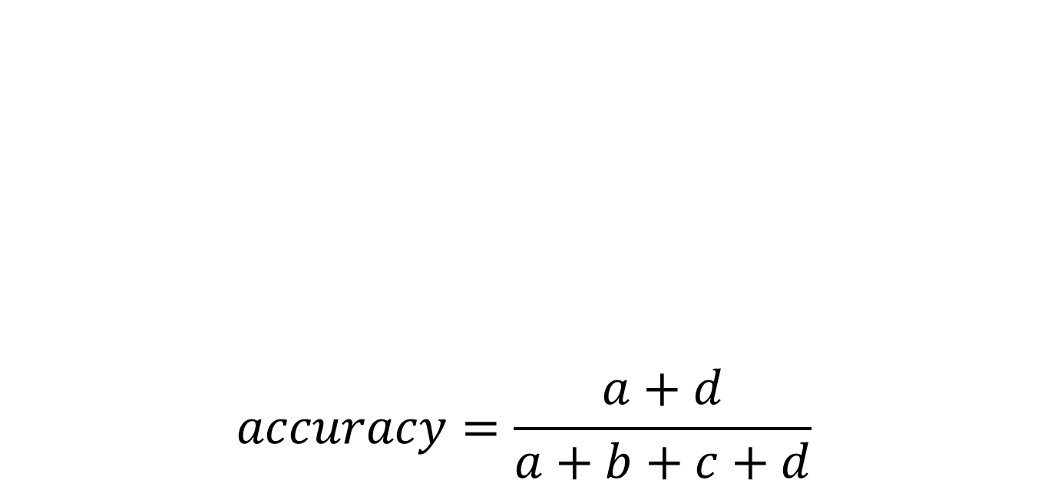
Classification accuracy – confusion matrix
$$accuracy=\frac{a+d}{a+b+c+d}$$
 | PREDICTED CLASS
ACTUAL CLASS |  | Class=Yes | Class=No
 | Class=Yes | a (TP) | b (FN)
 | Class=No | c (FP) | d (TN)

Slide 58
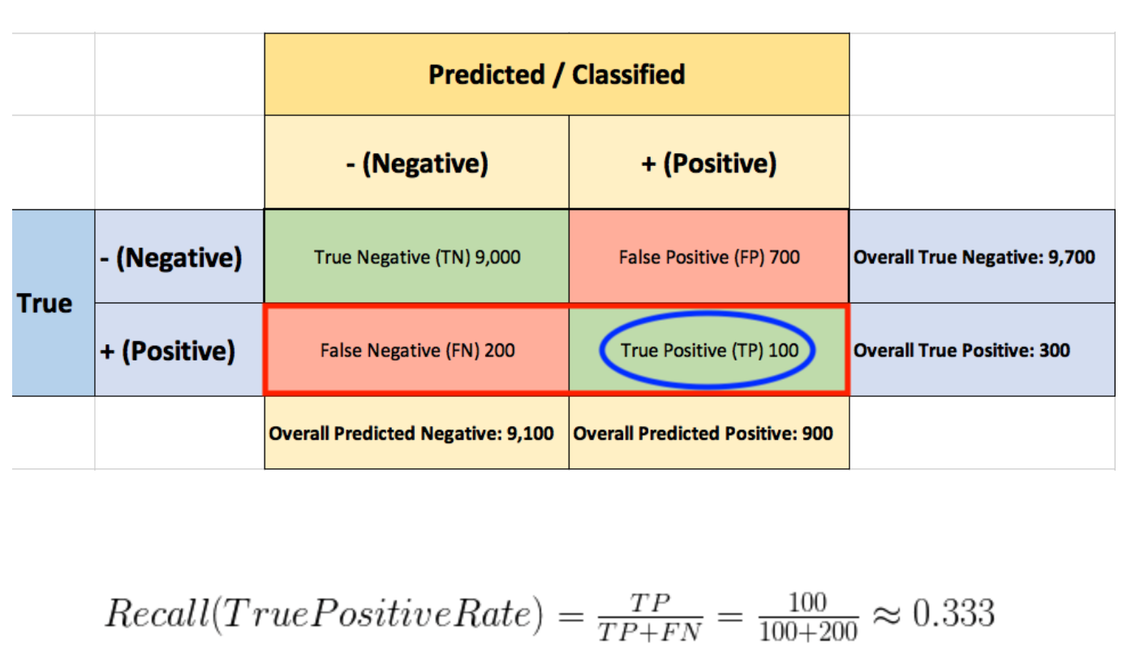
Recall

Slide 59
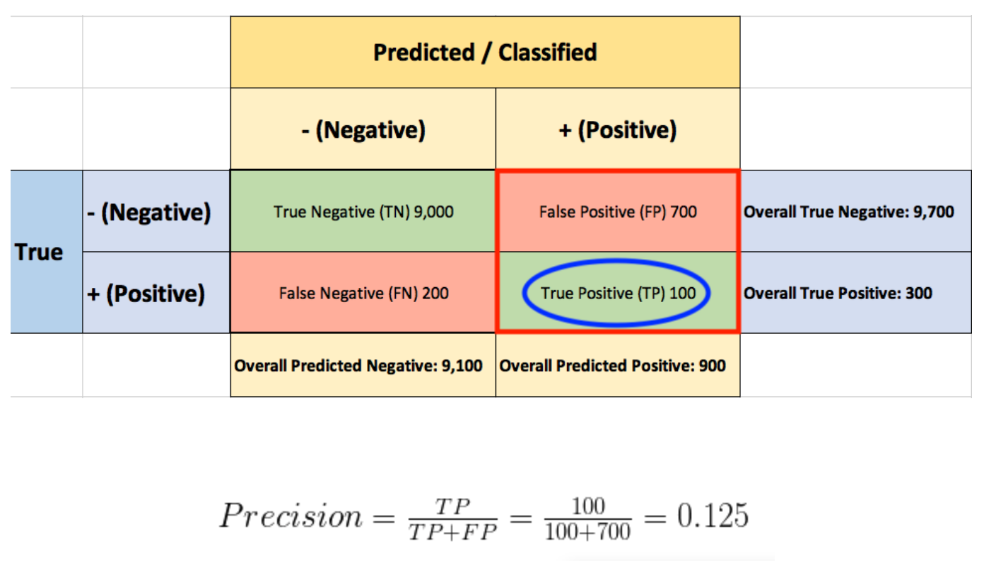
Precision

Slide 60
ROC curve
In classification, we usually look for the golden mean between achieving high precision and sensitivity. The overall classifier performance, summarized for all possible threshold values, is determined by the receiver-operator-curve (ROC).
The name "ROC" is historical and is derived from the theory of communication. ROC curves are used to test how well the classifier can separate positive and negative examples and to determine the best threshold to separate them.

Slide 61
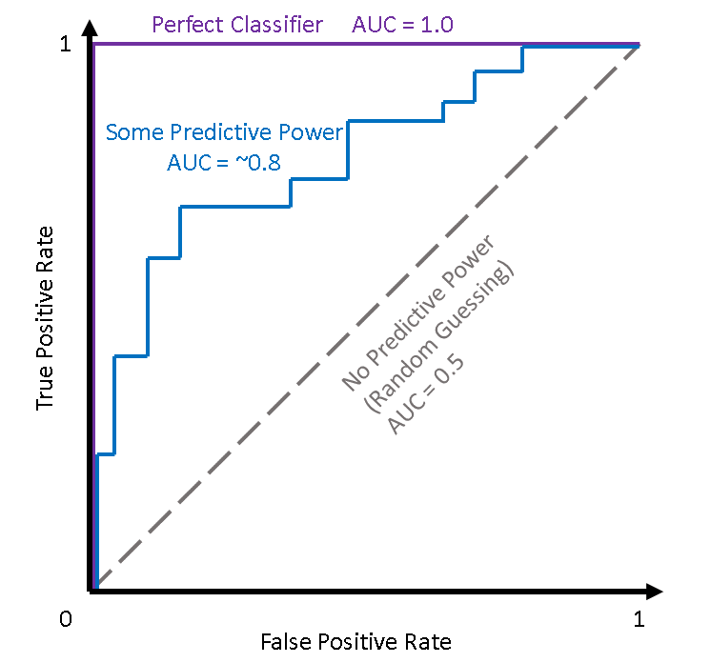
Area Under Curve (AUC)

Slide 62
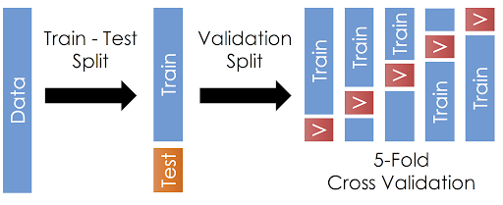
Training process – cross-validation

Slide 63
K-fold cross-validation
It enables the use of the entire data set both for training and for model validation.
It is used to determine the quality of the model already during its adaptation / learning in order to eliminate the problem of overfitting.
It consists in dividing the training set into k parallel subsets, of which k-1 is used for model training / adaptation (as a training set), and 1 subset is used to validate the model (validation set).
The selection of the parameter k depends on the size of the data set and its type. For large sets - small k, for smaller data sets - larger k values, so as not to reduce the training set.
It is important to ensure a division proportional to their number and the representation of individual classes.

Slide 64
Thank you for your attention!

